Slide 1













TIME SERIES FORECASTING: Week 3

Slide 2




DSBA CURRICULUM DESIGN
CORE COURSES
DOMAIN APPLICATIONS
FOUNDATIONS
Data Science Using Python
Advanced Statistics
Finance and Risk Analytics
Statistical Methods for Decision Making
Data Mining
Predictive Modelling
Marketing and Retail Analytics
Machine Learning Data Visualization
SQL
Time Series Forecasting (Week-3/4)

Slide 3


LEARNING OBJECTIVE OF THIS COURSE
Time Series Analysis
Time Series Forecasting –
Introduction to Forecasting
ARIMA Models

Slide 4

LEARNING OBJECTIVES OF THIS SESSION
Concepts of Stationarity, ACF, PACF
ARIMA models

Slide 5











TRY ANSWERING THE FOLLOWING
A model chosen by the lowest AIC values (an auto ARIMA) will always give better results for prediction on the test data as compared to a model chosen by looking at where the ACF and the PACF cuts-off. True or False? Discuss
All models are ARMA/SARMA models (with or without exogenous variables) with correct degree or order of differencing. True or False? Discuss.

Slide 6

BROAD OVERVIEW
Check for stationarity before building ARIMA models and pay close attention to the ACF and PACF plots.
ARIMA models gives us the statistical significance of each Auto- Regressive terms, Moving Average Terms and the exogenous variable terms, if any.

Slide 7

Industry Application – Predicting Arrhythmia with Time Series
Time Series Forecasting procedures are nowadays often used to predict irregularities in the beating of the heart. An ECG (ElectroCardioGram) records the electrical activity of the heart and this output can be used to forecast heart problems in the future with the help of sophisticated Time Series Forecasting tools.
As we have seen, there are a lot of applications of Time Series Analysis and Time Series Forecasting in various fields.
An example of such is given: ECG Anomaly Detection via Time Series Analysis.

Slide 8
Understanding the Models: To Explain or To Predict?
In an analytics professional’s journey a very vital or important question is whether you are looking to explain the dependent variable or you are looking to predict the dependent variable with maximum accuracy or least error.
There are various models which might be considered a black-box but helps you predict your target variable with maximum accuracy or least error.
On the other hand, there are models which does not predict the dependent variable with maximum accuracy (or minimum error) but gives you an idea about the causation of the dependent variable with respect to the independent variable.
Note: Please refer to this lecture by Galit Schmueli to get an understanding of this particular concept.

Slide 9

CASE STUDY- Forecasting the Retail Sales of a brick and mortar store.
In this particular case study, we are going to look at some of the descriptive measures of statistics to understand the data a bit better. Then we will go ahead and split the data into training and test. After this, we will build different ARIMA models on the data and choose the most optimum model.
The data that we have ranges from 2000 to 2015. This particular case study is of retail sales forecasting and analysis of a brick and mortar store.

Slide 10
Additional Material for Week 3
The additional content for Week 3 contains the concepts of building (S)ARIMA models with exogenous variables and how those variables help in the prediction of the desired Time Series.
The end to end case study session will take you through the various methodologies learnt in this course so far along with the SARIMAX models.

Slide 11











ANY QUESTIONS

Slide 12


Apply Data Science at your workplace to gain some instant benefits:
Get noticed by your management with your outstanding analysis backed by data science.
Create an impact in your organization by taking up small projects/initiatives to solve critical issues using data science.
Network with members from the data science vertical of your organization and seek opportunities to contribute in small projects.
Share your success stories with us and the world to position yourself as a subject matter expert in data science.

Slide 13
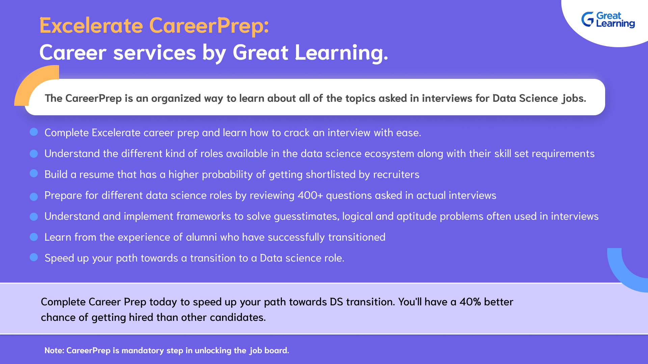

Slide 14

HAPPY LEARNING
Proprietary content. ©Great Learning. All Rights Reserved. Unauthorized use or distribution prohibited.

